Slide 1
Lundi, 27 avril
Le dictionnaire
Learning objective:
To feel more confident in using a dictionary.

Slide 2


Slide 3
Le dictionnaire
Why use a dictionary?
to look up new words
to check spellings
to find out genders or plurals
How confident do you feel at using a dictionary on a scale of 1-5?

Slide 4
How is the dictionary organised?
In two halves, French-to-English and English-to-French
Headwords (in colour) = the words you are looking up
Words at top of page = the first and last entry on each page
Entries in alphabetical order

Slide 5
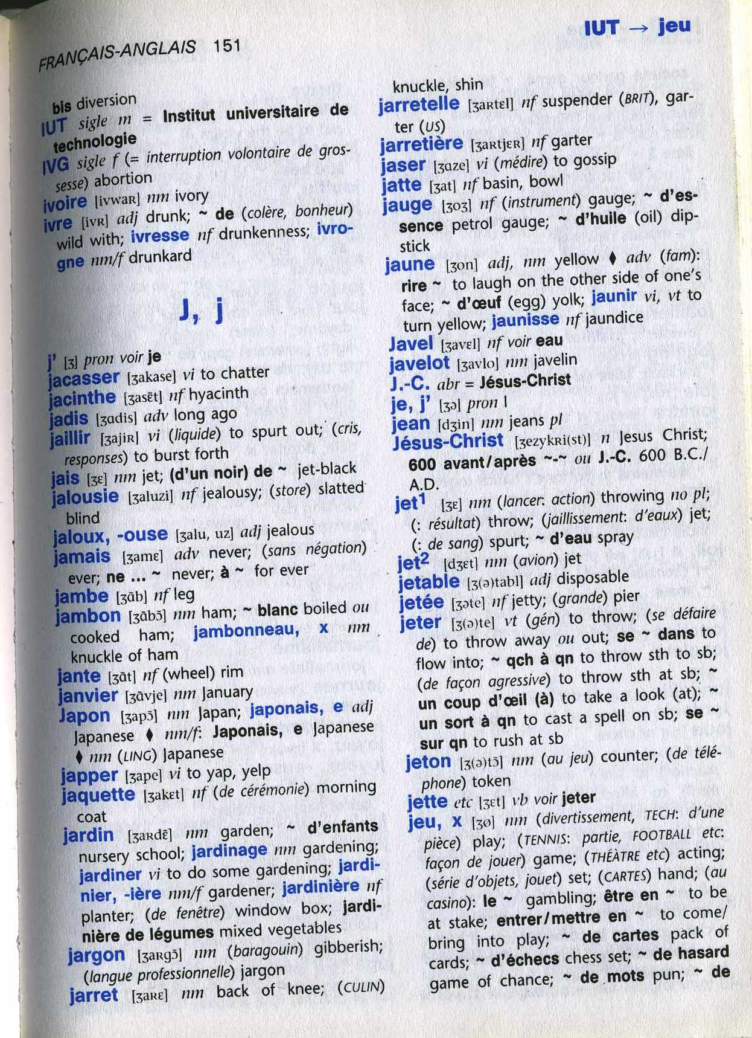

Slide 6
Put the following in alphabetical order
Paris
Lille
Nantes
Le Havre
Perpignan
La Rochelle
Nice
Rouen
La Rochelle
Le Havre
Lille
Nantes
Nice
Paris
Perpignan
Rouen

Slide 7
Write down 6 items of clothing in French
Now look them all up in the French-English part of the dictionary
Time how long it takes you
Did you find them all?
Did you spell them all correctly?
Did it take longer than you expected?

Slide 9
Understanding a dictionary entry Highlight as you go!
Don’t look up ‘le’ or ‘la’!
Headword jeu – the word you wanted
[ʒø] phonetic spelling, ie. pronunciation
,x the last bit of this tells us the plural so jeux will become jeux
nm = noun, masculine so it is a le word
(divertissement, TECH: d’une piece) this tells us the context or usage of the word
Look for other meanings of jeux
Other abbreviations: n = noun, adj = adjective, vi/vt = verb

Slide 10
Now look up ‘richesse’ in the French section
CLUE!
You will not always find the word you want as a headword !

Slide 11
Have you got the right word?
Look up the English word ‘flier’ (leaflet)
What French word did you find?
Is there more than one?
Which is best?
Now go to the French section and look up dépliant and aviateur to check.
If a word in English has two meanings in French, it is always best to check in the French side too!

Slide 12
Use your dictionary to find the odd one out!
brouillard grêle éclair puce orage
aboyer arroser miauler roucouler ronronner
l'ardoise l'acier le fer le cuivre l'or
le morse la sauterelle l'abeille la guêpe la mouche

Slide 13
How confident are you now?
1
2
3
4
5?

